Slide 1
North Fork Park Planning Objective
“Holy Grail”
Created March 2022

Slide 2
Mission Statement
North Fork Park is a four-season natural park that strives to provide the public with recreation and relaxation opportunities while still preserving the park’s peaceful, serene environment and vital natural resources for future generations.

Slide 3
Operational Philosophies
Exercise thoughtful planning – appropriately modernize while maintaining the integrity of the wilderness surroundings.
Incorporate a mindset of wisely accommodating multiple users throughout the park.
Remain environmentally conscious with wise execution of planning to preserve resources.
Educate users on efforts they can take for wise stewardship of the park.

Slide 4
Projects on the Radar
2022 – 2027 Goals

Slide 5
Trails in the Park
Investigate possible mountain bike specific training course, separate of current trail system
Installation of tunnel to connect upper park with lower park for trail users
Initiate secondary school mountain biking volunteer participation/trail maintenance program
Nordic Activities in the Park
Redesign South Gate entrance to accommodate more parking
Investigate feasibility of potential year-round building for recreation programming at South Gate
Marketing the Park
Brand promotion - #NorthForkin’
Camping in the Park
Improvement of 30% of the individual camp sites for leveling and width
On-line reservation system for 25% of individual camp sites
Yurt village expansion – 3 additional yurts or tree houses
South Bowery group site refinement
Improvements to Middle Gate individual camp sites to accommodate limited mobility patrons
Replace/relocate fire rings as necessary
Develop 6-8 easy access “back country” back packing sites

Slide 6
Dark Skies in the Park
Installation of dark sky friendly solar lights at restrooms
Installation of Pluto for Ogden Valley solar system display
Resource Management in the Park
Addition of water isolation shut-off valves within park water system
Improvements at UTABA Reservoir for expanded use (State and Federal participation)
Possible introduction of vault toilets to day use areas of the park
Roadways in the Park
Asphalt replacement/repair/installation in key areas
Continual maintenance and improvements of all road base roadways, manage run-off issues
Management of the Park
Update Title 18 – Parks ordinance as necessary for park management consistency and best practice

Slide 7
Branding efforts to cultivate reputation of the unique experiences North Fork Park provides.
#NorthForkin’
#Can’tStopNorthForkin’
#respectthepark
#parkinthedark

Slide 8
Summer Trails
Minimal plans for additional trail development. Focus is on improving and maintaining current trails to promote high quality multi-use trails throughout park. Improvement and/or replacement of trail signage is in continual motion.

Slide 10
Winter Trails
Continue with collaborative partnership with Ogden Nordic to promote cross country skiing, snow shoeing and fat bike usage in the park during the winter season.
Although winter trail development is complete, Weber County will work with Ogden Nordic for replacement and expansion of the yurt at the South Gate.

Slide 12
Camping Options
Individual and Group Sites Available.

Slide 13
Camp Site Plans
Camp fees are the primary generator of revenue for North Fork Park.
A portion of the sites will be improved to accommodate larger RVs of today.
On-line reservation system for limited individual sites will accommodate demand.
Development of easy access “back country” back packing site for “off the grid” experience.
South Bowery improvements to accommodate multiple RVs.

Slide 14
Starry Skies – International Dark Sky Park
Designated in April 2015 – world’s 21st IDA Park, 90 parks worldwide now.
Best practices in park to maintain Bronze Accreditation.
Work with Ogden Valley Starry Nights to accommodate educational and recreational events.

Slide 15
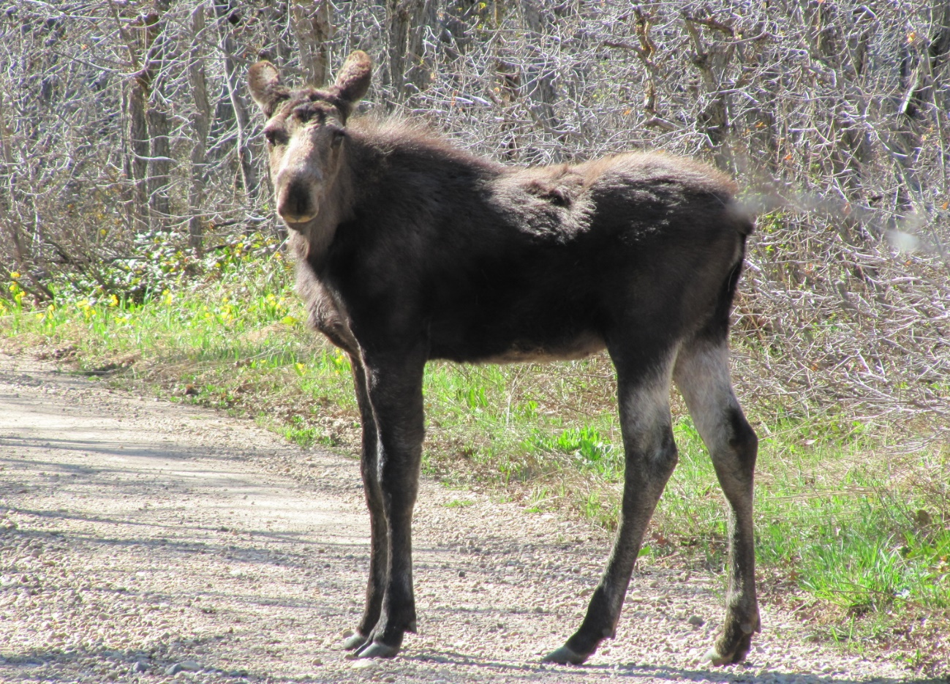
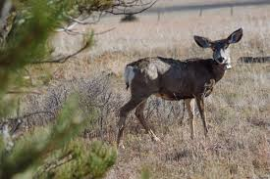
Wildlife in North Fork Park

Slide 16
Habitat for wildlife is continually shrinking – I can at least provide a weigh station. - Peter Coyote -
Pressing pause on further significant development in the park. Ensure we have use balance that will allow the wildlife in the park to remain.
Opportunities are given in North Fork Park:
Explore back country areas of the park and adjacent Forest Service land via trails to experience wildlife.
Four season use allows for experiences is a unique winter setting.

Slide 17
Conclusion What we’ll do moving forward.
Provide unparalleled proactive stewardship of North Fork Park.
Continually advocate for a multi-use park for residents and visitors.
Plan for and protect wildlife considerations within North Fork Park.
Install practices that encourage all users to enjoy and appreciate the park.

